Slide 1

A Report on
SUMMER IN-PLANT TRAINING/INTERNSHIP
A Training report submitted in partial fulfillment of the requirement for
award of the Degree
BACHELOR OF TECHNOLOGY
in
AGRICULTURAL ENGINEERING
By
B. G. Pranavasai 19JQ1A3581
DEPARTMENT OF AGRICULTURE ENGINEERING
KAKINADA INSTITUTE OF TECHNOLOGY & SCIENCE
Approved by AICTE DELHI, affiliated to JNTU, Kakinada accredited with NAAC (B+)
THIRUPATHI (V) DIVILI, PEDDAPURAM (M) -533433, East Godavari District,
ANDHRA PRADESH
(2019 -2023)

Slide 2
Irrigation

Slide 3
Introduction
Irrigation is the agricultural process of applying controlled amounts of water to land to assist in the production of crops, as well as to grow landscape plants and lawns, where it may be known as watering.
Irrigation is the artificial application of water to the soil through various systems of tubes, pumps, and sprays.
Irrigation is usually used in areas where rainfall is irregular or dry times or drought is expected.

Slide 4
Necessity of irrigation
If rainfall is less than the demand for plants, irrigation is necessary to fulfill the water requirement of plants.
The difference in water holding capacity of the soil plays an important role in the Necessity of Irrigation supply.
For example, sandy soil requires frequent irrigation than clay soil.

Slide 5
Development of irrigation in india
India’s irrigation is mostly groundwater well based.
At 39 million hectares (67% of its total irrigation), India has the world’s largest groundwater well equipped irrigation system (China with 19 mha is second, USA with 17 mha is third).
India has spent ₹ 16,590 crore on irrigation development between 1950 and 1985.

Slide 6
Some of the developments are :
Extension of Irrigated areas
Development of Multi-purpose Projects
Development of Minor Irrigation Projects
Command Area Development Programme
Irrigation Commission and its Principles

Slide 7
1. Extension of Irrigated Area:
Five year plans have made extensive arrangement for extending the area under irrigation. At the time of independence, about 19 per cent of agricultural land of India was under irrigation system as against 41 per cent in Pakistan, 36 per cent in Israel, 52 per cent in Japan and near 100 per cent in Egypt. During the planning period, stress has been laid on the extension of irrigation facilities throughout the country.
As a result of that, at the end of 1997-98, 86.6 million hectares of land was irrigated which comes about 46.5 per cent of total cultivable area (186 million hectares) of the country? Among all the states, the extent of coverage of irrigation is highest in Punjab (73 per cent) followed by 50 per cent coverage in Haryana.

Slide 8
2. Development of Multi-purpose Projects:
In the meantime a good number of multi-purpose river projects has been completed under the plans for extensive utilisation of river water for irrigation purposes along with other uses.

Slide 9
3. Development of Minor Irrigation Projects:
Five year plans in India have also made extensive arrangement for the development of minor irrigation projects including wells, tanks, tube wells, pump sets etc. to extend irrigation facilities to small and marginal farmers.

Slide 10
4. Command Area Development Programme:
In 1974-75, the Command Area Development Programme was launched for the maximum possible utilisation of irrigation potential. Its main objective is to reduce the gap between the actual irrigation potential and its utilisation.
This scheme was also introduced for increasing the agricultural production from the irrigated commands. This programme envisaged execution of on farm development works like construction of field channels, land leveling or shaping and adoption of the warabandi system (network of distributaries over the command area) for rotational supply of water and construction of field drains.

Slide 11
Classification of irrigation project based on cultural command area :
​Irrigation Projects in India are classified into three categories viz. Major, Medium and Minor Irrigation. Those Irrigation Projects which have a CCA of 2,000 hectares or less are known as Minor projects.
Major Irrigation Projects: The area envisaged to be covered under irrigation is of the order over 10000 hectare (CCA>10,000 ha). This type of project consist huge storage reservoirs, flow diversion structures and a large network of canals.

Slide 12
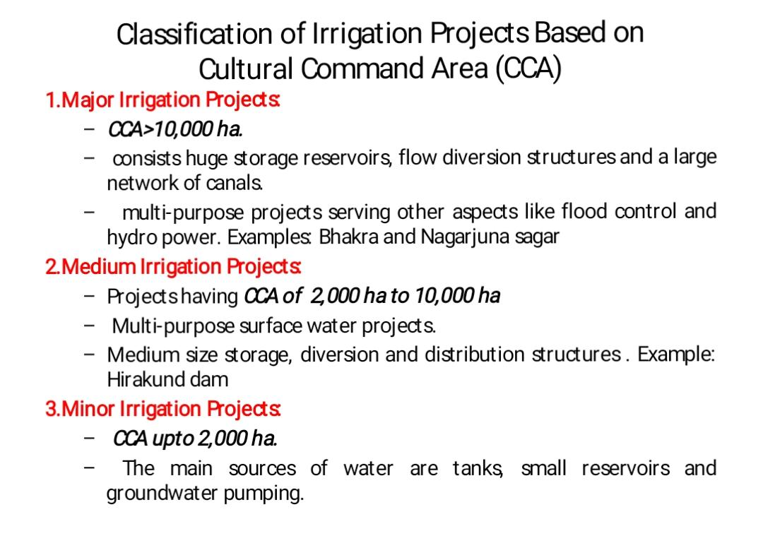

Slide 13
Sprinkler irrigation :
An irrigation sprinkler is a device used to irrigate agricultural crops, lawns, landscapes, golf courses, and other areas.
They are also used for cooling and for the control of airborne dust. Sprinkler irrigation is the method of applying water in a controlled manner in way similar to rainfall.

Slide 14
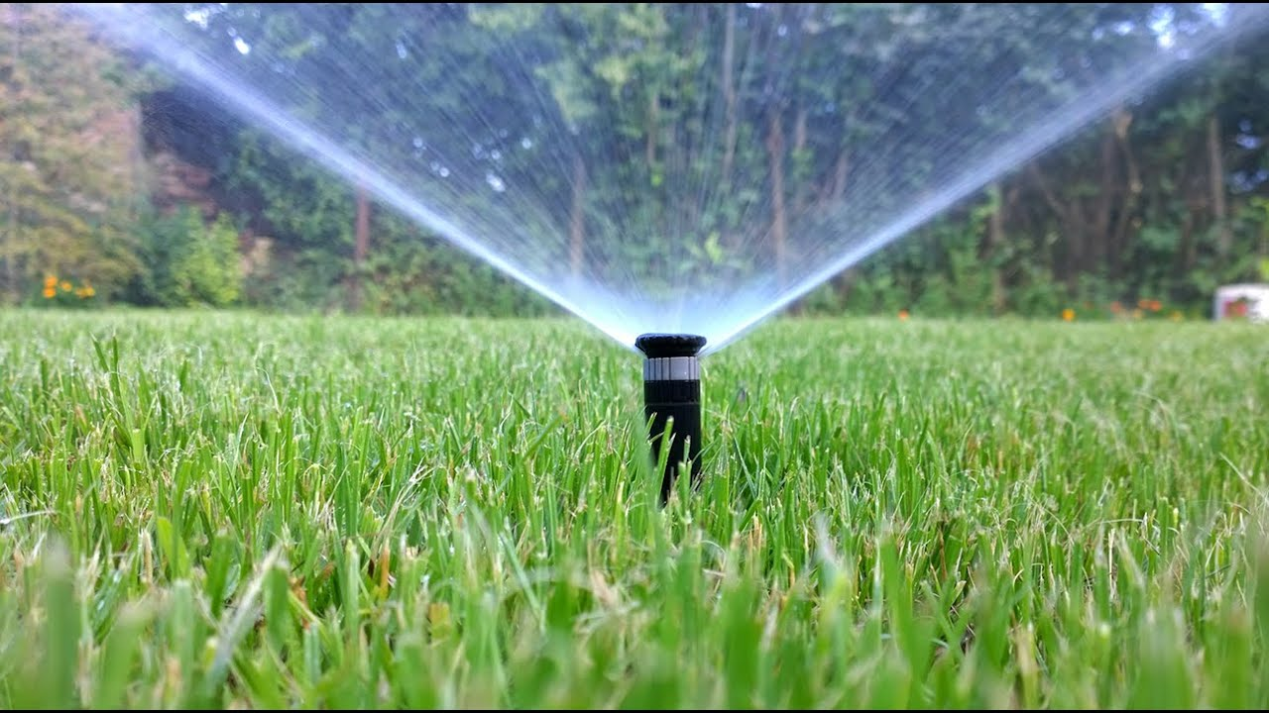

Slide 15
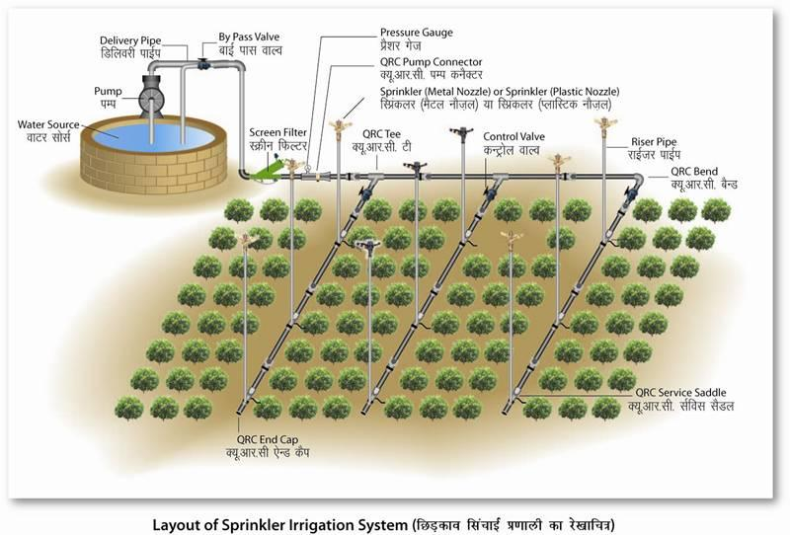

Slide 16
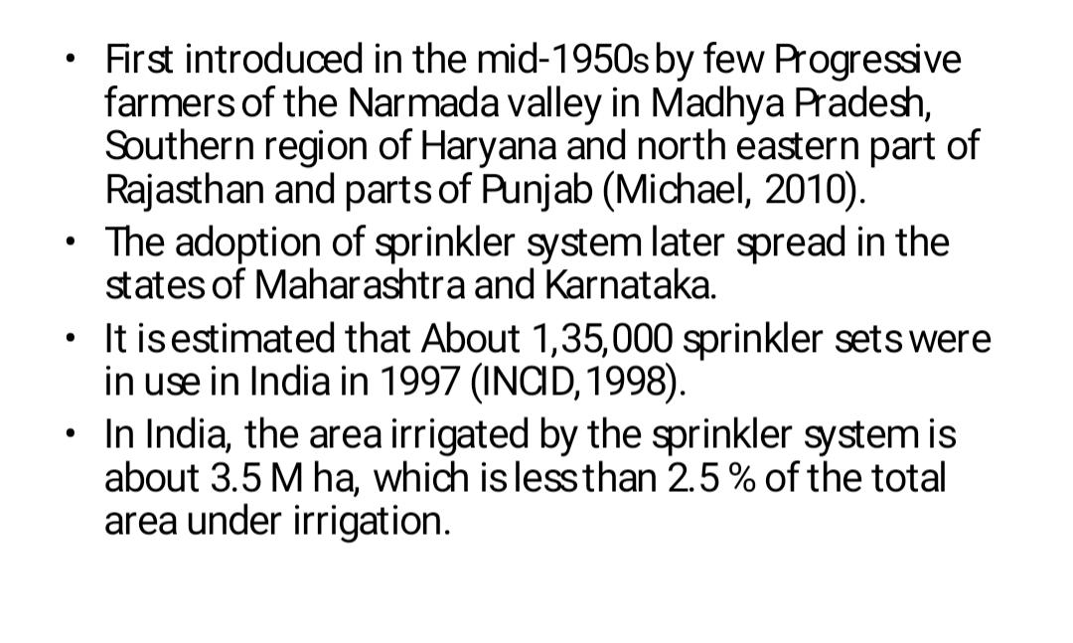
Historical overview of sprinkler irrigation

Slide 17
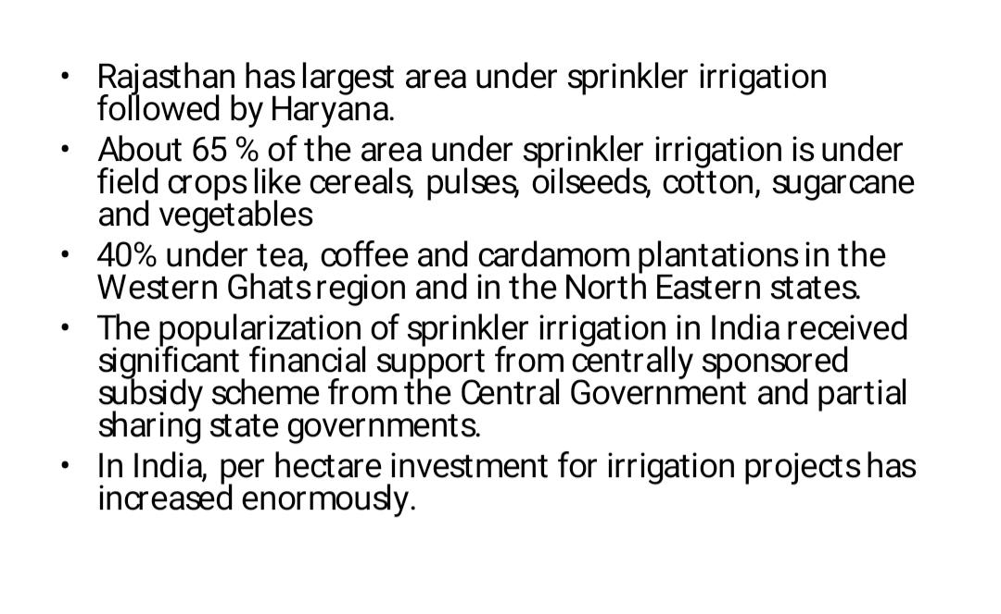

Slide 18
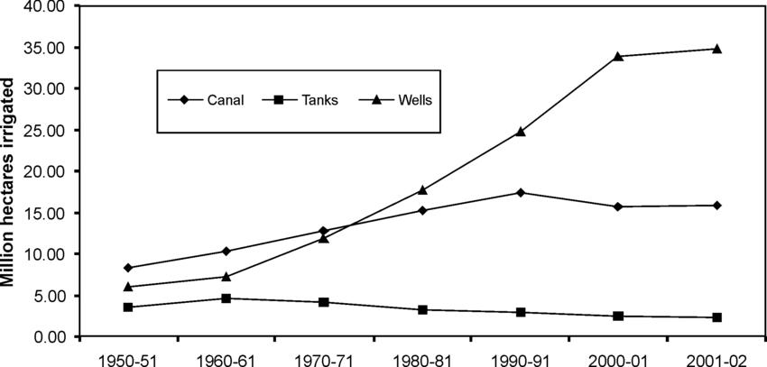

Slide 19
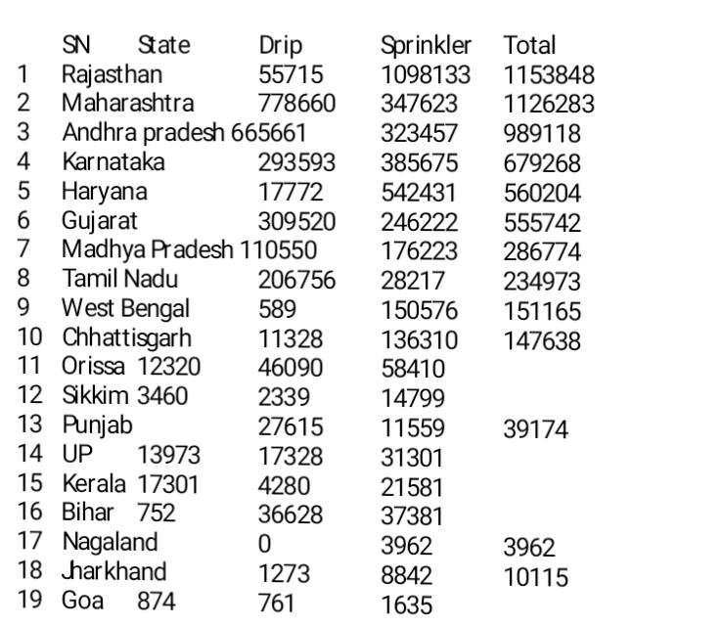
Table 1.1. area under Micro irrigation :

Slide 20
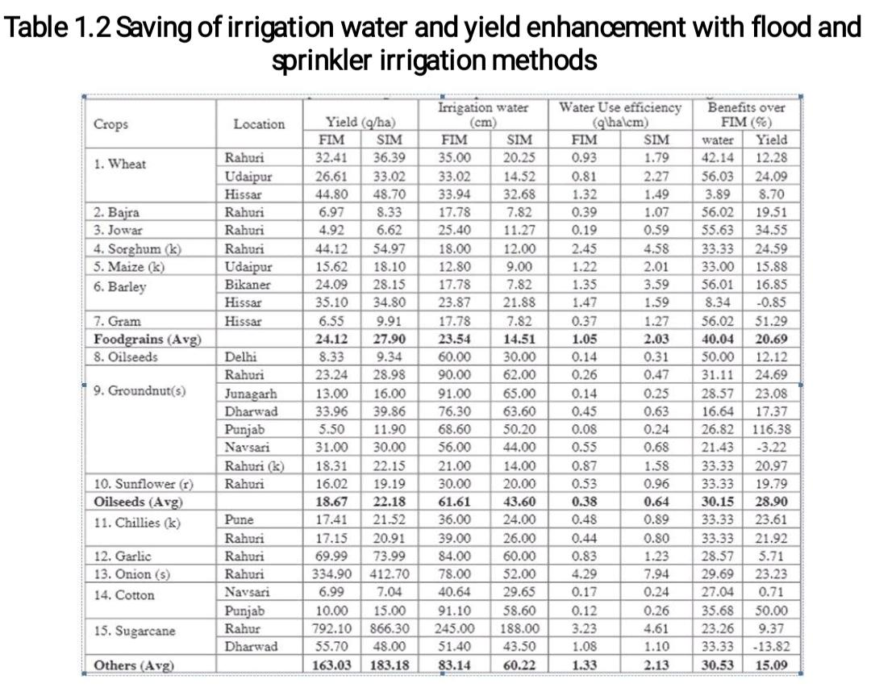

Slide 21
Adoptability of sprinkler irrigation system :
Sprinkler irrigation can be used for almost all crops (except rice and jute) and on mot soils however, it is not usually suitable in very fine textured soils ( heavy clay soils), where infiltration rates are less than 4 mm per hour.
The method is particularly suitable to sandy soils that have high infiltration rates.

Slide 22
Limitations of sprinkler irrigation system :
1. It requires high initial investment.
2. Power requirement is usually high since sprinklers operate with more than 0.5 kg/cm2 water pressure.
3. Fine textured soils that have low infiltration rate can not be irrigated efficiently in host windy area.
4. Loss of water due to evaporation from the area during irrigation.
5. The water must be clean and free of sand, debris and large amounts of dissolve salts.
6. Wind distorts sprinkler pattern and cause uneven distribution of water.

Slide 23
Types of sprinkler irrigation system :
Sprinkle irrigation systems are classified on the basis of portability of different components and on the basis of spray pattern. On the basis of portability these can be portable, semi portable, semi-permanent and permanent.
The success of sprinkler irrigation system depends on the selection of appropriate sprinkler type and their components.

Slide 24
Classification based on Spray pattern :
Sprinkler systems are classified into the following two major types (on the basis of the arrangement for spray of irrigation water).
i. Rotating head or revolving sprinkler system.
ii. Perforated pipe system.

Slide 25
Rotating Head :
In this type of system small spraying size nozzles are placed on pipes of certain height known as riser pipes.
The nozzles mounted on the riser pipes are fixed at uniform intervals along the length of the pipe laid on the ground surface called as lateral pipes.
Water is supplied from the source to laterals through network of pipes consisting of mainline and sub mainline, called as main and sub main.

Slide 26
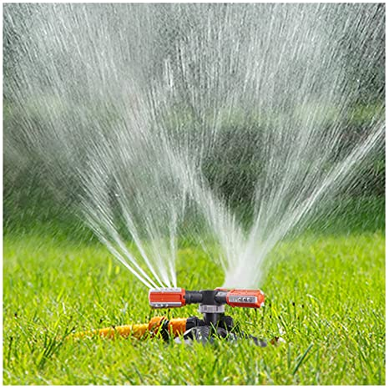

Slide 27
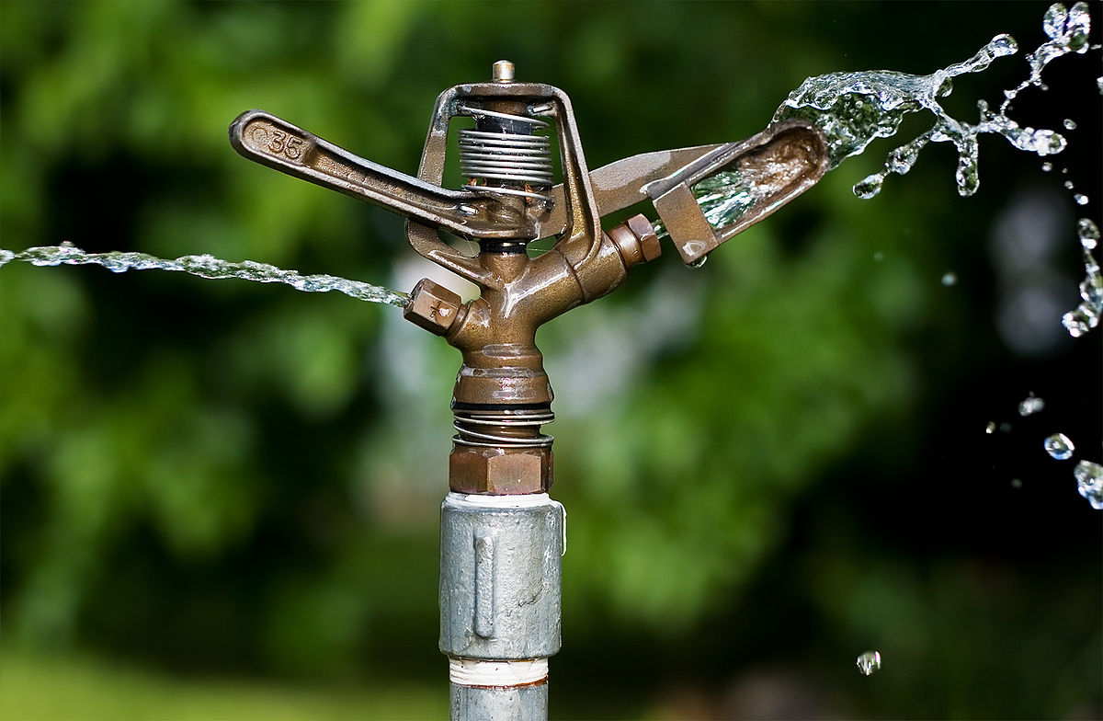

Slide 28
Water with pressure is supplied to main; main to sub main and sub main to laterals using a pump.
The sprinkler heads mounted on the risers which are above the crop height and rotated through 90o to 360o, to irrigate a rectangular strip.
In rotating type sprinklers, the most common device to rotate the sprinkler nozzle is a small hammer activated by the thrust of water striking against a vane connected to it.
The pressure requirement varies from 2.0 to 4.0 kg cm-2 with application rate from 4.0 to 20.0 mm hr-1 depending on the nozzle size, spacing etc. Fig. 36.1. shows different type of rotating type sprinkler irrigation systems.

Slide 29
PerForAted pipe System
This system consists of pipes having holes or nozzles along its length through which water is sprayed under pressure.
This system is usually designed for relatively low pressure (1 kg cm-2). The application rate ranges from 1.25 to 5 cm per hour for various pressure and spacing.

Slide 30
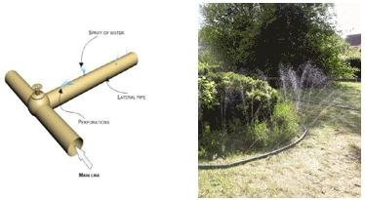

Slide 31
Classification based on The portability : 1. portable system:
A portable system has portable mainlines, submains, laterals, and a portable pumping unit.
The entire system can be moved from field to field.
As all the components of the system need to be moved, the labour requirement is high; however initial investment on this type of the system is less.

Slide 32
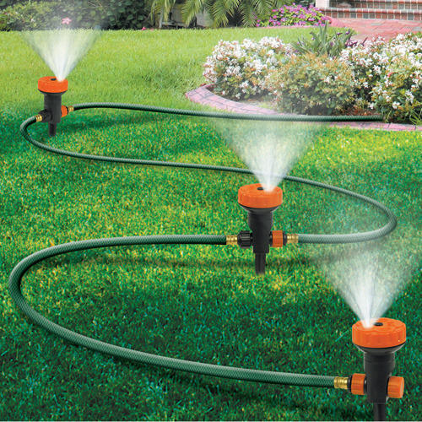

Slide 33
Semi-portable system :
A semi-portable system is similar to a portable system except that the location of water source and pumping plant is fixed.
Other components are moved from one field to another. Such a system may be used for more than one field where there is an extended mainline, but may not be used for more than one farm unless there are additional pumping units.

Slide 34
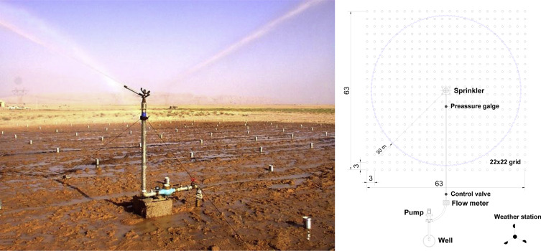

Slide 35
Semi-permanent system :
A semi-permanent system has portable lateral lines, permanent mainlines, submains, and a stationary water source with pumping unit.
The mainlines and/or submains are usually buried. The risers are located for nozzle connections at suitable intervals to connect with laterals.

Slide 36
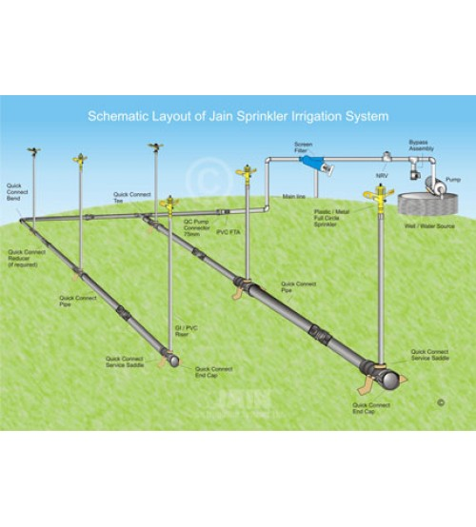

Slide 37
Permanent system :
A permanent system has buried mainlines, submains, and laterals with a stationary pumping plant and/or water source.
Sprinkler nozzles are permanently located on each riser. Such systems are expensive, however these are suitable for automation.
Permanent systems are suitable for orchards.

Slide 38
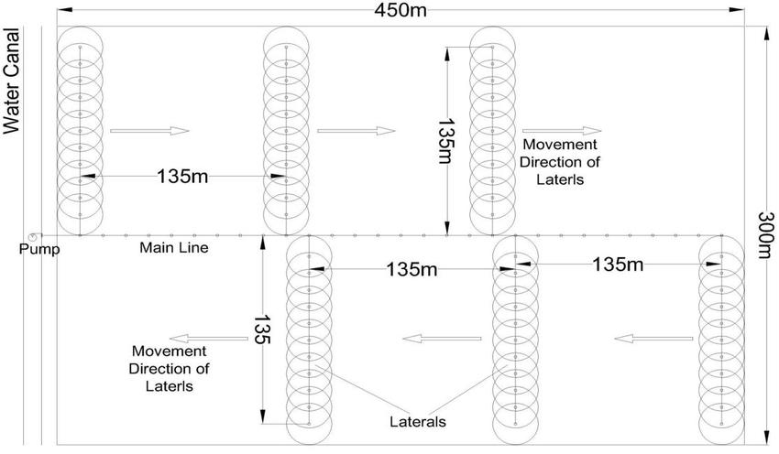

Slide 39
Solid set system :
In case of a solid set system, the movement of laterals is eliminated at least for one crop season their movement.
The laterals are positioned in the field before the crop season starts and kept there for the whole crop season.
This system is beneficial when frequent moving of the laterals is not required crops need frequent irrigation in small depth.

Slide 40
SeT mOve system :
Set-move sprinkler irrigation systems are moved from one set (irrigation) position to another by hand or mechanically.
Set-move systems remain stationary when water is applied. When the desired amount of water has been applied, the water is shut off and the sprinkler laterals are drained and moved to the next set position.
When the move is complete the water is turned on and irrigation resumed at the new set position. This sequence is repeated until the entire field has been irrigated. Set-move systems commonly have a single mainline laid through the centre of the field with one or more laterals on each side of the mainline.

Slide 42
Components of the sprinkler irrigation system :
Sprinklers or nozzles, laterals, sub-mains, and mainlines are the primary components of a sprinkle irrigation system. Sprinklers spread water as “rainlike” droplets over the land surface.
Laterals receive water from the mainline and sub-main and convey to the sprinklers. Mainlines convey water from the water source to the sub-mains and laterals.
A sprinkler system usually consists of the following components.

Slide 43
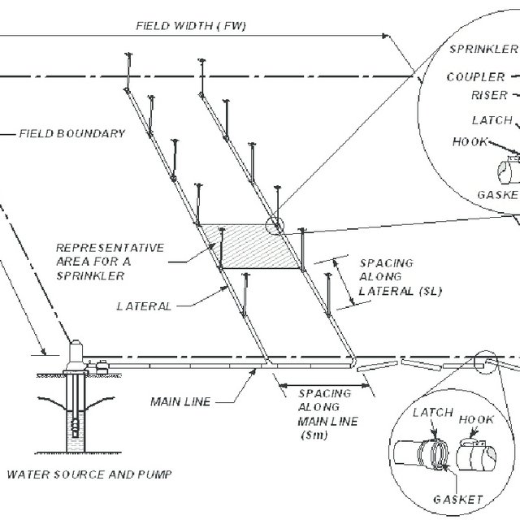

Slide 44
Pumping unit :
Sprinkler irrigation system distributes water by spraying it over the fields. The water from the source (ground water / surface water) is pumped under pressure to sprinkler system. The pressure created through pump forces water through sprinklers or through perforations or nozzles in pipelines and then forms a spray.
A high speed centrifugal or turbine pump can be used for operating sprinkler irrigation to individual fields.
Centrifugal pump is used when the distance from the pump inlet to the water surface (suction head) is less than eight meters. For pumping water from deep wells or more than eight meters, a submersible pump is used.

Slide 45
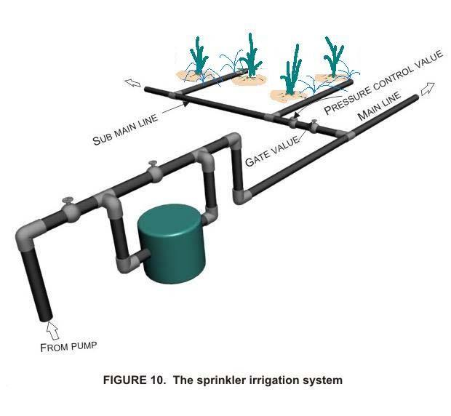

Slide 46
Filter application unit :
Soluble chemical fertilizers can be injected into the sprinkler system and applied to the crop.
The fertilizer applicator consists of a sealed fertilizer tank with necessary tubings and connections. A venturi injector is connected with the main line, which creates the differential pressure to suck fertilizer solution to flow in the main line.
Filters are used to filter the suspended particles and debris flowing with water.

Slide 47
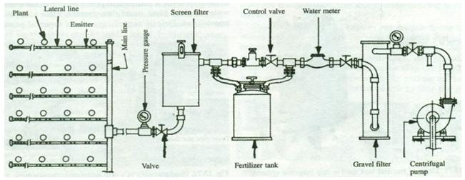

Slide 48
Pipe network :
The pipe network consists of mains/submains and laterals. Main line conveys water from the source and distributes it to the submains.
The submains convey water to the laterals which in turn supply water to the sprinklers. Aluminium or PVC or HDPE pipes are generally used for portable systems, while steel pipes Asbestos, cement, PVC and wrapped steel are also used for buried laterals and main lines. usually used for center-pivot laterals.

Slide 49
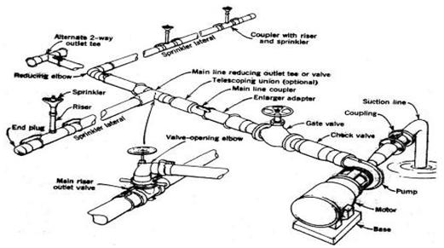

Slide 50
Sprinkler head :
Sprinkler head distributes water uniformly over the field without generating runoff and loss due to deep percolation. Types of sprinklers are rotating head or fixed type. The rotating type can be adopted for a wide range of application rates and spacing.
They are effective with pressure of about 10 to 70 m head at the sprinkler. Pressures ranging from 16 to 40 m head are considered to be the most practical for normal uses.

Slide 51
A) Water meters: It is used to measure the volume of water delivered in to the system. This is necessary to operate the system to supply the required quantity of water.
B) Flange, couplings and nipples are used for proper connection to the pump, suction and delivery.
C) Pressure gauge: It is used to measure operating pressure of sprinkler system. The sprinkler system is operated at the pressure to apply the desired depth of water and ensure application uniformity.
D) Bend, tees, reducers, elbows, hydrants, butterfly valve and plugs are other components of a sprinkler system. They are used as per requirements.

Slide 52
Operation and maintenance of sprinkler irrigation system :
Good operation of any irrigation system includes matching the irrigation duration with the rate of application and the intake rate of soil to maximize the fraction of water stored in the root zone.
To achieve uniform application, the sprinkler spacing or move distance need to be adjusted to compensate for variations due to wind or exceptionally hot summer days.
The system should be operated in keeping with good irrigation practices. It should be ensured that the prime mover and the pump are in alignment. For these the drive shaft as well as the pump shaft should lie at nearly the same height to prevent too great an angle on the universal shaft.

Slide 53
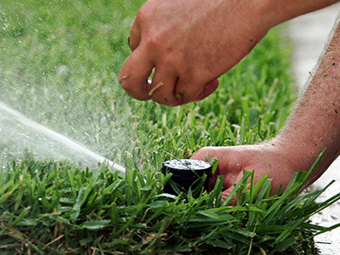

Slide 54
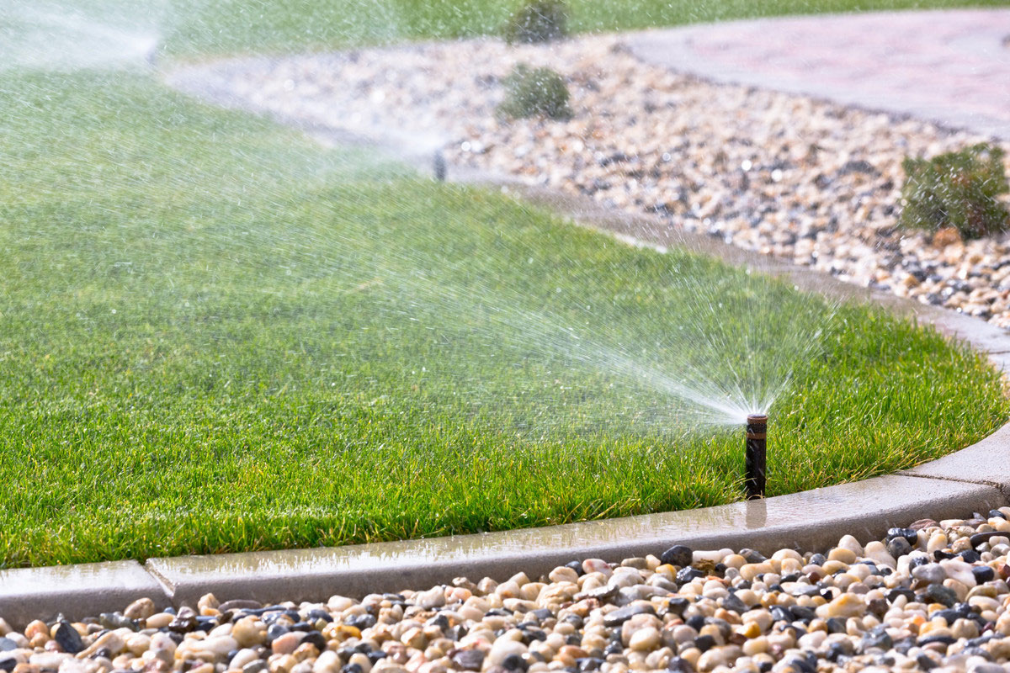

Slide 55
Maintenance :
Irrigation system maintenance is necessary to ensure most efficient use of water that is being applied. The best design cannot compensate for inadequate system maintenance. Maintenance actually deals with system installation.
Improper installation will cause trouble throughout the life of the system. A sprinkler system like any other farm equipment needs maintenance to keep it operating at peak efficiency.
Parts of the system subject to wear are the rotating sprinkler heads, the pumping set, the couplers and the pipeline.

Slide 56
Pipes and fittings :
The pipes and fittings normally do not need much maintenance. The following precautions can be observed for pipes and fittings:
Any dirt or sand accumulated on the groove of the coupler in which the rubber sealing ring fits be occasionally cleaned. The pipes made up of Aluminum or plastics should not be dumped on the damp concrete or fertilizer sacks.
The pipes are automatically emptied and ready to be moved. When the pump is first started and before the pressure has built up in the system the seals may give a little leakage. With full pressure in the system the couplers and fittings will be effectively leak free.

Slide 57
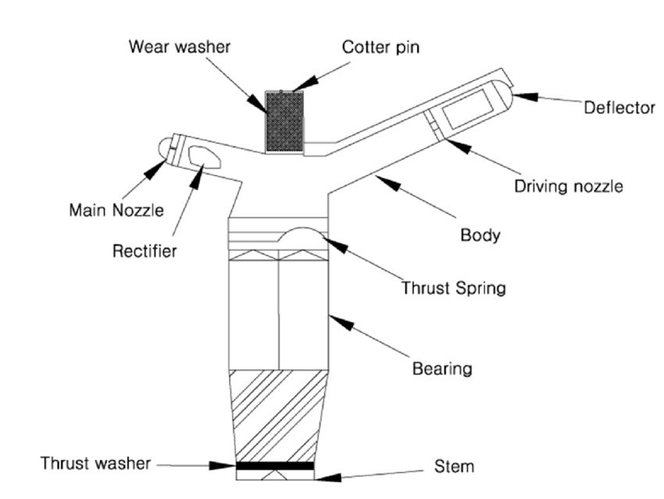

Slide 58
Trouble shooting of sprinkler irrigation system :
The following are the general guidelines to identify and remove the common troubles in the sprinkler systems:
1) Pump does not prime or deliver water:
A) The pump suction lift should be checked, is it within the limits? If not it lower the pump closer to the water surface.
B) Air leak from the suction pipeline and all connections should be checked. All connections and flanges should be made air tight.
C) The strainer of the foot valve should be checked for blockage.
D) Check that the flap in the foot valve in free to open fully.
E) Check the pump gland (s) for air leaks. If required repack the gland (s) using a thick grease to seal the gland satisfactorily.

Slide 59
2. Sprinklers do not turn.
a) The operation pressure of pump should be checked.
b) Check that the nozzle is not blocked. Preferably unscrew the nozzle or use a small soft piece of wood to clear the blockage.
c) Sprinkler bearing should be free and smooth. Sprinkler can usually be pushed down towards the riser pipes so that the water pressure flushes out the bearing. If the bearing is still stiff dismantle and then clean it. Oil, grease or any lubricant should not be used.

Slide 60
3. Leakage from Coupler or Fittings.
The sealing rings in the couplers and fittings are usually designed to drain the water from the pipes when the pressure is turned off. This ensures that the pipes are automatically emptied and ready to be moved. When the pump is first started and before the pressure has built up in the system the seals may give a little leakage. With full pressure in the system the couplers and fittings will be effectively leak-free. If, however, there is a leakage, check the following:
A) There is no accumulation of dirt or sand in the groove in the coupler in which the sealing ring fits. Clean out any dirt or sand and refit the sealing ring.
B) The end of the pipe going inside the coupler is smooth, clean and not distorted.

Slide 61
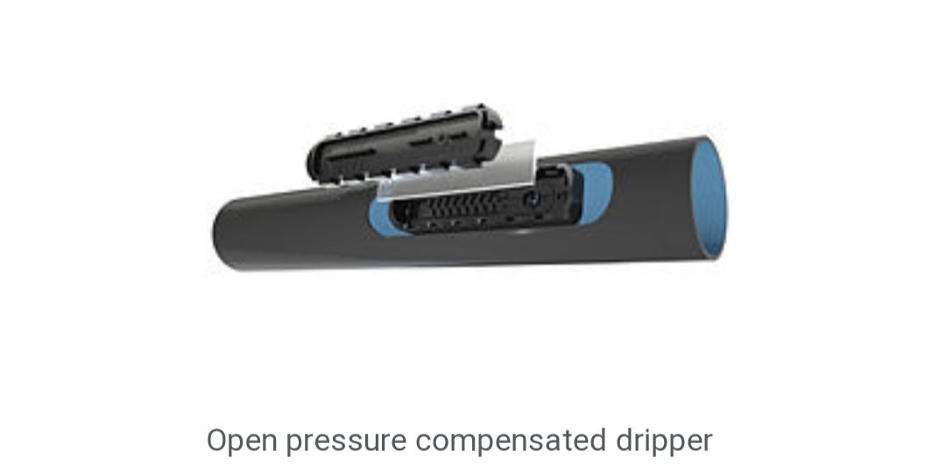
Drip irrigation system :
Drip irrigation or trickle irrigation is a type of micro-irrigation system that has the potential to save water and nutrients by allowing water to drip slowly to the roots of plants, either from above the soil surface or buried below the surface.

Slide 62
The goal is to place water directly into the root zone and minimize evaporation.
Drip irrigation systems distribute water through a network of valves, pipes, tubing, and emitters.
Depending on how well designed, installed, maintained, and operated it is, a drip irrigation system can be more efficient than other types of irrigation systems, such as surface irrigation or sprinkler irrigation.

Slide 63
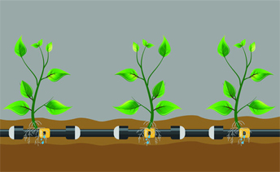

Slide 64
Maintenance of drip irrigation system :
Drip irrigation systems are a necessary part of any modern greenhouse facility. The simplest drip irrigation system is made up of the following components:
1. pressure regulator
2. filter
3. Tubing ( irrigation lines)
4. Emitters ( Drippers )

Slide 65
Filter :
The drip system filter should be checked every day and cleaned if necessary.
Disc and screen filters are available on the market. The preference should be given to disc filters, as they are more resistant to clogging and easier to clean through back flushing. Check lines for leaks.

Slide 66
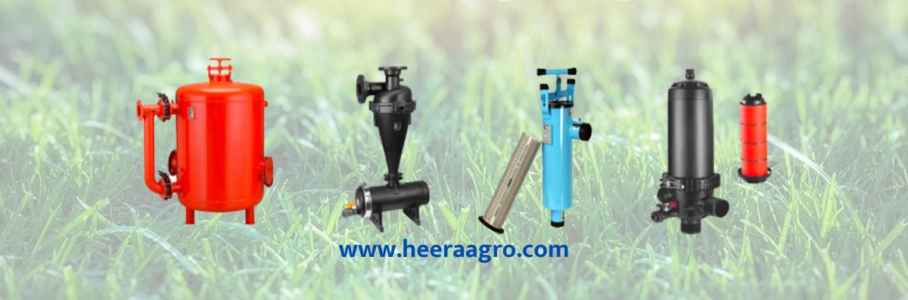

Slide 67
Emitters :
A pH higher than 6.0, and high EC (electrical conductivity), may lead to precipitation of calcium and magnesium salts, which will clog the emitters. Precipitates may build up to the end of the season even when precautions have been taken. Partially clogged emitters may still conduct feeding solution, but they will distribute nutrients unevenly among the plants. Therefore, the lines should be flushed with nitric acid at the end of each season to remove build-up.

Slide 68
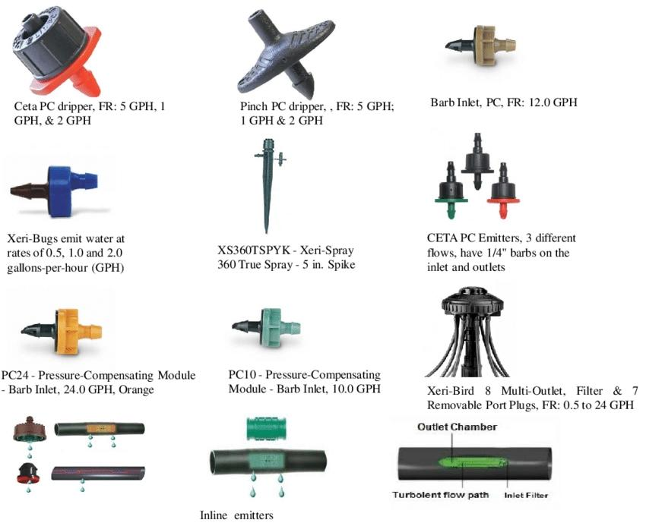

Slide 69
Irrigation lines ( tubing ) :
Although Nitric acid is a most efficient solubilizer, sulphuric and phosphoric acids can be used too. Flushing lines for 1 hour with pH 4.5 solution is usually effective enough. However, you can leave the solution in the lines overnight if you have a particularly tough precipitate build up. Flush the lines with water afterward. Avoid precipitate build-up through preventive measures rather than drastically eliminating it at the end of the season.

Slide 70
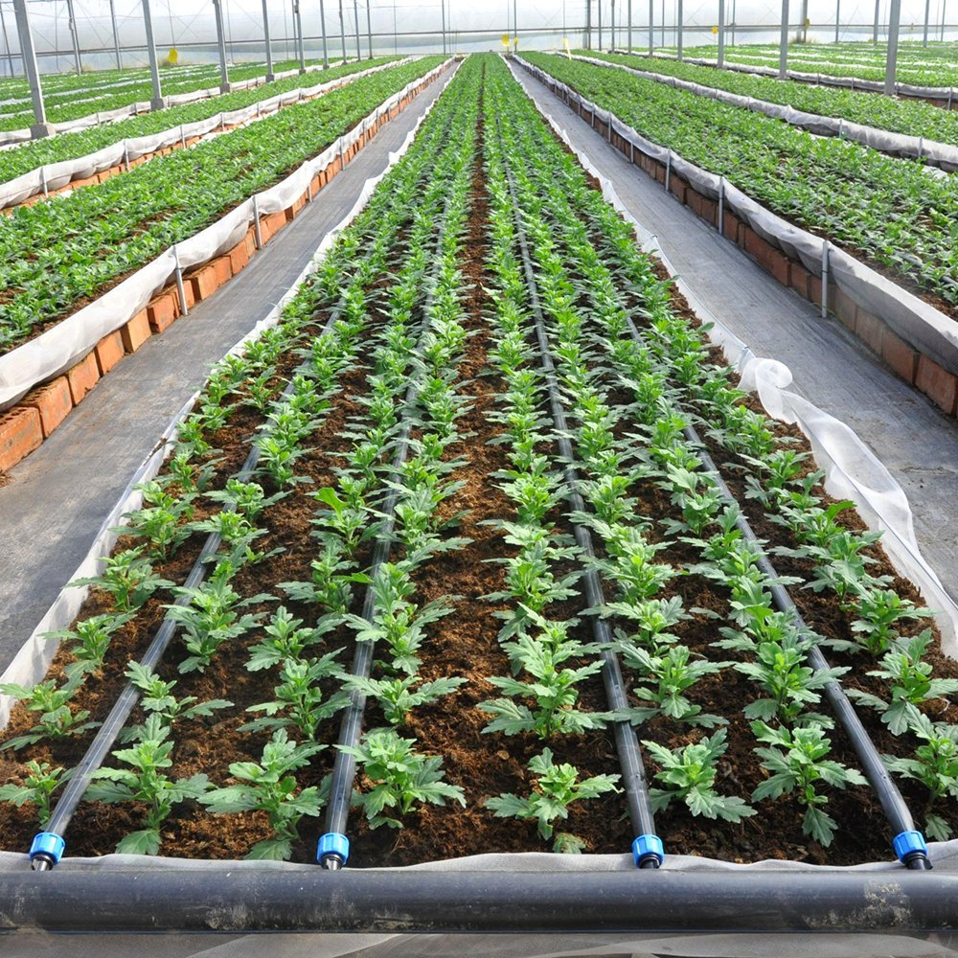

Slide 71
Components of drip irrigation system :
Components used in drip irrigation (listed in order from water source) include:
1. Pump or pressurized water source.
2. Water filter(s) or filtration systems: sand separator, Fertigation systems (Venturi injector) and chemigation equipment (optional).
3. Backwash controller (Backflow prevention device).
4. Pressure control valve (pressure regulator).
5.Distributionvicees (main larger diameter pipe, maybe secondary smaller, pipe fittings)
6. Hand-operated, electronic, or hydraulic control valves and safety valves.

Slide 72
7. Smaller diameter polyethylene tube (often called “laterals”).
8. Poly fittings and accessories (to make connections).
9. Emitting devices at plants (emitter or dripper, micro spray head, inline dripper or inline drip tube).
In drip irrigation systems, pump and valves may be manually or automatically operated by a controller.
Most large drip irrigation systems employ some type of filter to prevent clogging of the small emitter flow path by small waterborne particles. New technologies are now[when?] being offered that minimize clogging.

Slide 73
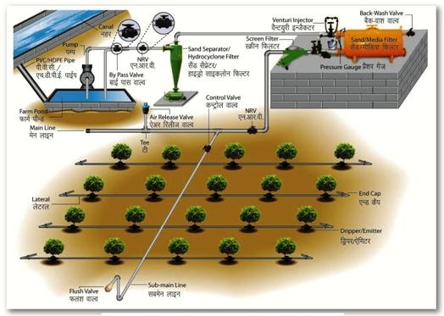

Slide 74
Some residential systems are installed without additional filters since potable water is already filtered at the water treatment plant. Virtually all drip irrigation equipment manufacturers recommend that filters be employed and generally will not honor warranties unless this is done. Last line filters just before the final delivery pipe are strongly recommended in addition to any other filtration system due to fine particle settlement and accidental insertion of particles in the intermediate lines.
Drip and subsurface drip irrigation is used almost exclusively when using recycled municipal wastewater. Regulations typically do not permit spraying water through the air that has not been fully treated to potable water standards.

Slide 76
Because of the way the water is applied in a drip system, traditional surface applications of timed-release fertilizer are sometimes ineffective, so drip systems often mix liquid fertilizer with the irrigation water.
This is called fertigation; fertigation and chemigation (application of pesticides and other chemicals to periodically clean out the system, such as chlorine or sulfuric acid) use chemical injectors such as diaphragm pumps, piston pumps, or aspirators.
Properly designed, installed, and managed, drip irrigation may help achieve water conservation by reducing evaporation and deep drainage when compared to other types of irrigation such as flood or overhead sprinklers since water can be more precisely applied to the plant roots.

Slide 77
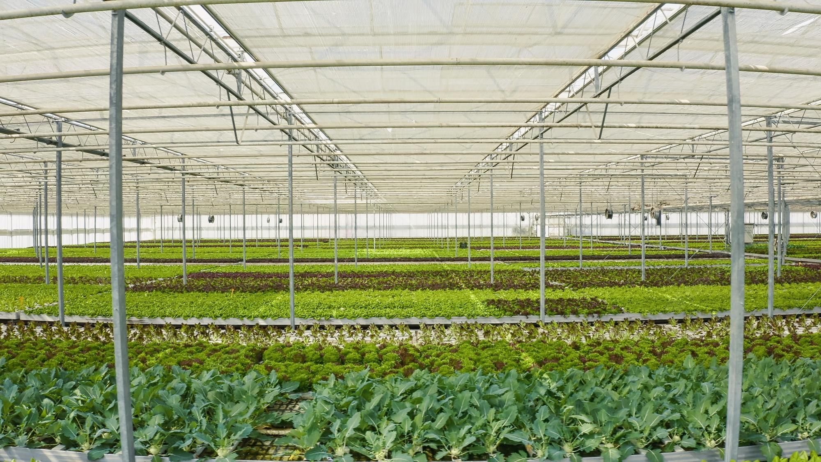

Slide 78
Pulsed irrigation is sometimes used to decrease the amount of water delivered to the plant at any one time, thus reducing runoff or deep percolation. Pulsed systems are typically expensive and require extensive maintenance. Therefore, the latest efforts by emitter manufacturers are focused on developing new technologies that deliver irrigation water at ultra-low flow rates, i.e. less than 1.0 L (2.1 US pints; 1.8 imperial pints) per hour.
An emitting pipe is a type of drip irrigation tubing with emitters pre-installed at the factory with specific distance and flow per hour as per crop distance.
An emitter restricts water flow passage through it, thus creating head loss required (to the extent of atmospheric pressure) to emit water in the form of droplets. This head loss is achieved by friction/turbulence within the emitter.

Slide 79
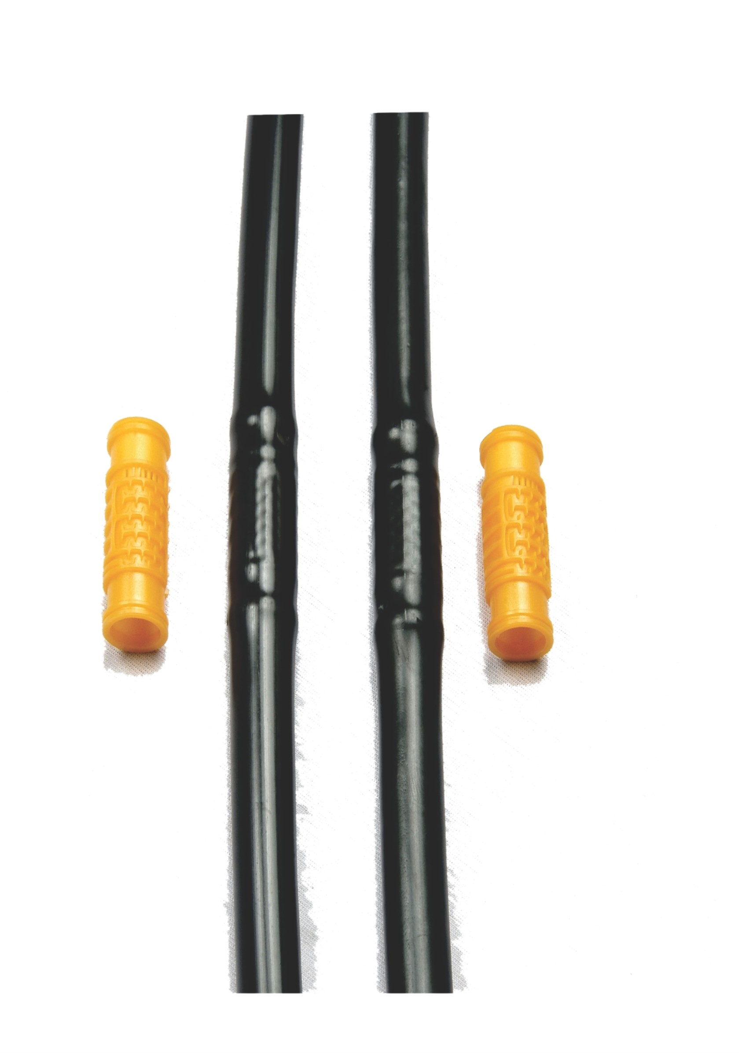
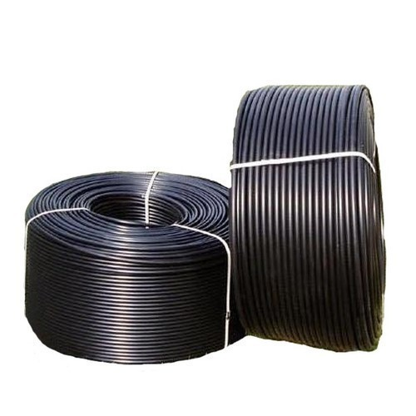

Slide 80
Advantages of drip irrigation :
Fertilizer and nutrient loss is minimized due to a localized application and reduced leaching.
Water application efficiency is high if managed correctly.
Field leveling is not necessary.
Fields with irregular shapes are easily accommodated.
Recycled non-potable water can be safely used.
Moisture within the root zone can be maintained at field capacity.

Slide 81
Disadvantages of drip irrigation :
Initial cost can be more than overhead systems.
Drip irrigation might be unsatisfactory if herbicides or top dressed fertilizers need sprinkler irrigation for activation.
Drip tape causes extra cleanup costs after harvest. Users need to plan for drip tape winding, disposal, recycling or reuse.
The PVC pipes often suffer from rodent damage, requiring replacement of the entire tube and increasing expenses.
Drip irrigation systems cannot be used for damage control by night frosts (like in the case of sprinkler irrigation systems)

Slide 82


